Slide 1
CSCIU 210 Computer Organization AKM Jahangir A Majumder, PhD
Fall 2018 - Lecture 17
October 3, 2018
Note: Some slides are adapted from those used by previous instructors and some slides include figures from the textbook.

Slide 2
Review and Learning Outcomes
We will continue to cover how to do math in the binary format and how to implement it in hardware
Review Exam 1
Decoder and Multiplexer
Homework 3 is due today at the beginning of the class
We will have quiz 3 today, which will be on lectures 10-15
We will have our Exam 1 on Friday, October 5, 2018, which will be on lecture 1-15
A sample exam with key is posted on Blackboard
Keys for HW 3 and Quiz 3 will post on Blackboard soon

Slide 3
The First Midterm Exam will be on Friday, October 5
Lectures 1-15.

Slide 4
Review of Computer Performance

Slide 5
CPU Time
Performance improved by
Reducing number of clock cycles
Increasing clock rate
Hardware designer must often trade off clock rate against cycle count

Slide 6
Instruction Count and CPI
Instruction Count for a program
Determined by program, ISA and compiler
Average cycles per instruction
Determined by CPU hardware
If different instructions have different CPI
Average CPI affected by instruction mix

Slide 7
Performance Summary
Performance depends on
Algorithm: affects IC, possibly CPI
Programming language: affects IC, CPI
Compiler: affects IC, CPI
Instruction set architecture: affects IC, CPI, T_{c}

Slide 8
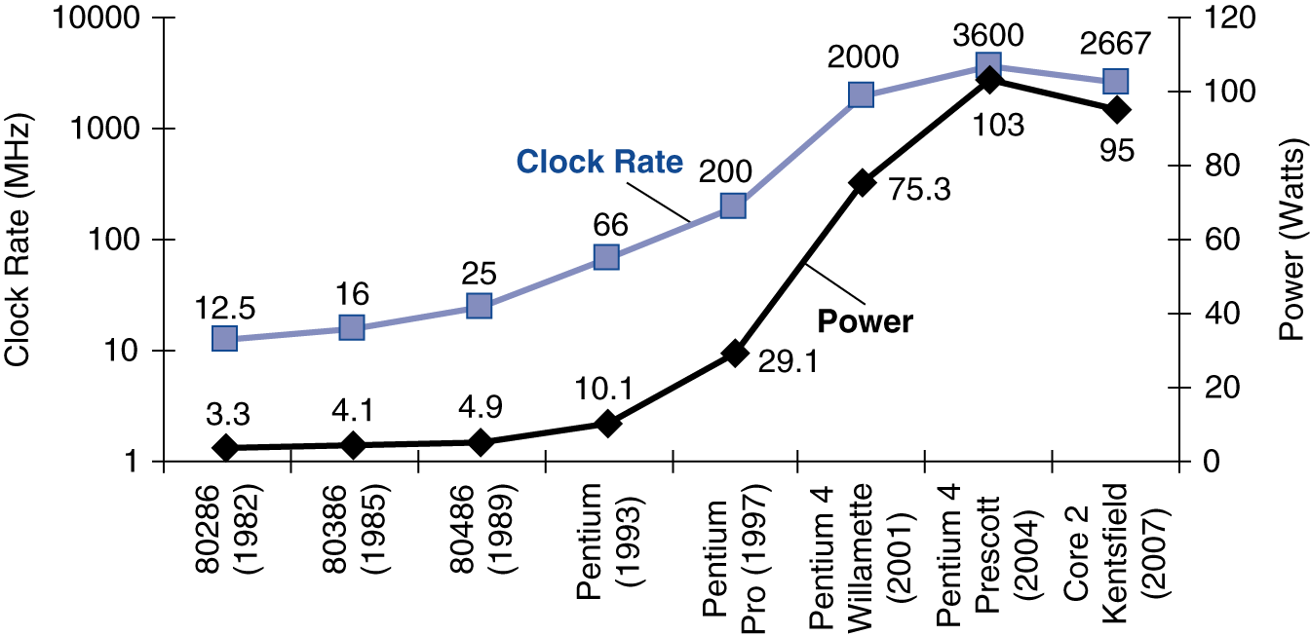
Power Trends
In CMOS IC technology
×30
5V → 1V
×1000

Slide 9
Reducing Power
Suppose a new CPU has
85% of capacitive load of old CPU
15% voltage and 15% frequency reduction
The power wall
We can’t reduce voltage further
We can’t remove more heat
How else can we improve performance?

Slide 10
Review of Combinational Logic and Binary Math

Slide 11
Different Logic Gates
A
A⋅B
A
(A.B)’
AND
NAND
B
B
A
A+B
A
(A+B)’
OR
NOR
B
B
A
(A+B)
A
A’
NOT
XOR
B
You need to memorize their symbols and functions

Slide 12
Boolean Algebra and Truth Table
Boolean algebra can be used to describe binary logic.
Boolean algebra operators (in the order of priority):
() : Parenthesis
‘ : NOT
⋅ : AND
+ : OR
Truth table can be used to represent input-output relations of a digital system.
You should be able to derive a truth table for a given logic circuit or Boolean algebra presentation and vice versa.

Slide 13
Example: Truth Table, Boolean Algebra, and Digital Logic Circuit
A | B | C | B⋅C | A+B⋅C
0 | 0 | 0 | 0 | 0
0 | 0 | 1 | 0 | 0
0 | 1 | 0 | 0 | 0
0 | 1 | 1 | 1 | 1
1 | 0 | 0 | 0 | 1
1 | 0 | 1 | 0 | 1
1 | 1 | 0 | 0 | 1
1 | 1 | 1 | 1 | 1
A
A+B⋅C
B
C
B⋅C

Slide 14
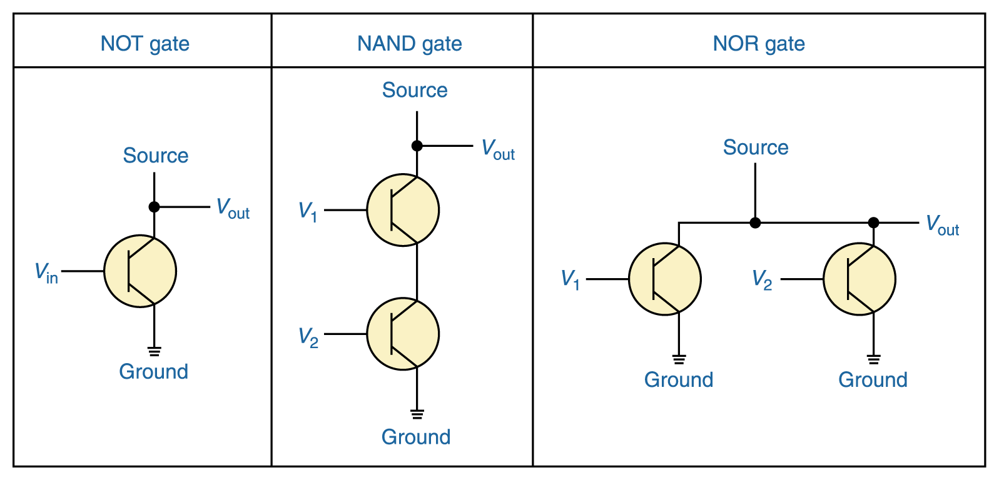
Constructing Gates
It turns out that, because the way a transistor works, the easiest gates to create are the NOT, NAND, and NOR gates

Slide 15
Laws of Boolean Algebra
Identity law
A + 0 = A
A⋅1 = A
Zero and One laws
A + 1 = 1
A ⋅0 = 0
Inverse laws
A + A’ = 1
A⋅ A’ = 0
Commutative laws
A + B = B + A
A . B = B . A
Associative laws
A + (B + C) = (A + B) + C
A . (B . C) = A . (B . C)
Distributive laws
A. (B + C) = (A.B) + (B.C)
A+(B . C) = (A+B) . (A+C)
DeMorgan’s laws
(A⋅B)’=A’+B’
(A+B)’=A’ ⋅B’

Slide 16
Binary Math: Base Conversion
In everyday life, we used decimal base system which uses 10 as base.
In computer systems, binary base and other related bases such as hexadecimal base are used.
Example:
3.25₁₀ =11.01₂
CF.1₁₆=11001111.0001₂
Note: In your exam, any conversion problem answer in format of M/N will receive no credit.

Slide 17
Binary Numbers
Some terminology and units
Bit (b): A single binary digit
Nib: 4 bits
Byte (B): 8-bits
Word: A group of bits of any size (often 4 bytes).
kb: 2¹⁰ bits = 1024 bits (kB = 2¹⁰ bytes)
Mb: 2²⁰ bits =1,048,576 bits (MB = 2²⁰ bytes)
Gb: 2³⁰ bits = 1,073,741,820 bits (GB = 2³⁰ bytes)
MSB: Most significant bit (leftmost digit of binary #)
LSB: Least significant bit (rightmost digit of bin. #)

Slide 18
Binary to Decimal Conversion
Binary Number:
···b₃b₂b₁b₀ (each bit b_{i} is 0 or 1)
Its decimal value is:
b₀×2⁰ + b₁×2¹ + b₂×2² + b₃×2³ + ···
= b₀×1 + b₁×2 + b₂×4 + b₃×8 + ···
Examples: 1110₂ Decimal value is:
1111₂ Decimal value is:
110010₂ Decimal value is:
111111₂ Decimal value is:
14
15
50
63
Check your understanding:
N bits → 2^{N} combinations → decimal numbers 0, 1, 2, 3, …, 2^{N} - 1
The largest number: 11…11₂ = 2^{N}-1 (decimal)
N bits, all ones

Slide 19
Other Conversions
Convert decimal to hex
Use the successive division method described previously (for decimal to binary), but divide by 16 instead of 2.
Convert binary to hex
A hex digit is equivalent to 4 bits.
Divide binary number into groups of 4 bits, starting from the right.
Convert each 4 bit group into one hex digit.
Convert hex to binary
Convert each hex digit to its 4-bit binary equivalent.
String the bits together.
Note: Computationally, it’s easy to convert between bases that are powers of 2, as indicated in the binary to hex conversion technique above.

Slide 20
Other Conversions
Convert decimal to Octal
Use the successive division method described previously (for decimal to binary), but divide by 8 instead of 2.
Convert binary to Octal
A octal digit is equivalent to 3 bits.
Divide binary number into groups of 3 bits, starting from the right.
Convert each 3 bit group into one octal digit.
Convert octal to binary
Convert each octal digit to its 3-bit binary equivalent.
String the bits together.
(examples on next slide)

Slide 21
Fractions
Binary to Decimal Conversion
Binary number: 0.b₋₁b₋₂b₋₃b₋₄···
Decimal value: b₋₁×2⁻¹ + b₋₂×2⁻² + b₋₃×2⁻³ + b₋₄×2⁻⁴ + ···
Example: 0.101₂ = 1×2⁻¹ + 0×2⁻² + 1×2⁻³ = 0.625₁₀
Decimal to Binary Conversion: Successive multiplication by 2
Example: Decimal number 0.6875
0.6875×2 = 1.375 → b₋₁ = 1 and 1.375-1 = 0.375
0.375×2 = 0.75 → b₋₂ = 0 and 0.75-0 = 0.75
0.75×2 = 1.5 → b₋₃=1 and 1.5-1 = 0.5
0.5×2 = 1 → b₋₄=1 and 1-1 = 0
Binary representation: 0.1011

Slide 22
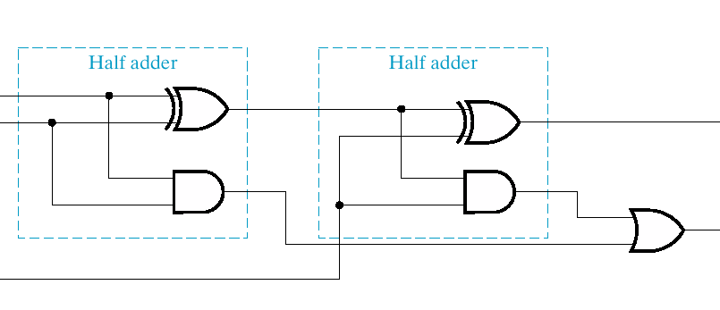
1 Bit Full Adder Implementation
a
sum
b
carry out
carry in
s
=
a
⊕
b
⊕
c_{in}
=
+
⊕
c_{out}
a
b
(
a
b
)
c_{in}

Slide 23
Binary Math: 2’s Complement
In binary world, people use 2’s complement to represent signed integer and implement subtraction.
The procedure of getting 2’s complement of a given number:
Invert every bit
Then add 1
For n bit signed integer, its representation is -2^{n-1} ~ 2^{n-1}-1
Example
11001100₂ = - (00110100)₂ = -52₁₀
10000000₂ = -128₁₀

Slide 24
2’s Complement Adder/Subtractor
Subtraction can be done by addition of the 2's Complement.
1. Complement each bit
2. Add 1 to the result.
The circuit shown computes A + B and A – B:
For S = 1, subtract, the 2’s complement of B is formed by using XORs to form the 1’s comp and adding the 1 applied to C₀.
For S = 0, add, B is passed through unchanged

Slide 25
Binary Math: Overflow Detection
Overflow happens when the calculation result is beyond the representation range for given number of bits.
Overflow might happen in one of following situations:
Positive + Positive
Negative + Negative
Positive – Negative
Negative – Positive
Important: You should determine whether an overflow happen by checking sign bits.
Example:
Overflow: 11000000+10000000=01000000 (the extra carry out bit is discarded)
Overflow: 01000000+01000000=10000000 (no extra bit)
No Overflow 01000000+11000000=00000000 (the extra carry out bit is discarded)

Slide 26
Good Luck!

